Slide 1


MIND – Recommender System
Guy Dahan
Guy Krothammer

Slide 2
The MIND Data
The data contains over 1 million users, 4.5 million articles and users’ behaviors (impressions)
The Mind-Small dataset – contains 50,000 users with corresponding articles and interactions.
Train-Test split

Slide 3
Goals
Define baseline for recommendations
Create methods for recommending the most relevant articles
Evaluate

Slide 4
Main Challenges
How to create the features?
How much of the data is relevant?
How to evaluate the results?
Very large data
Feature Engineering

Slide 5
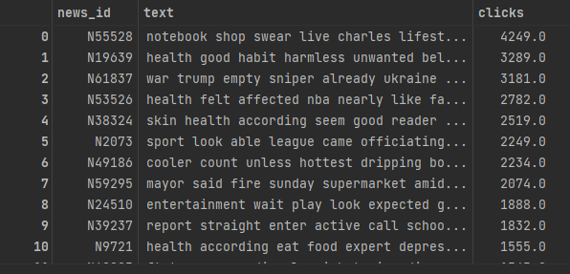
Data Processing
“Cleaning” the text
Stemming, lemmatization
Vectorizing using TF-IDF

Slide 6
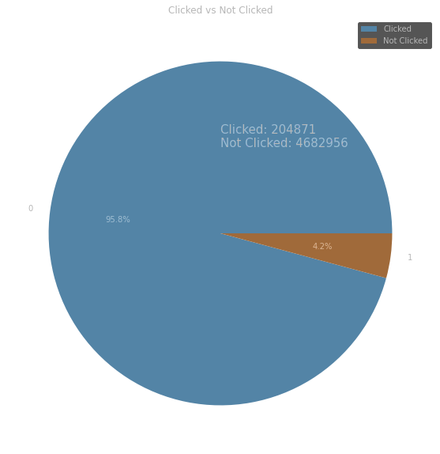
Users Don’t Click…

Slide 7
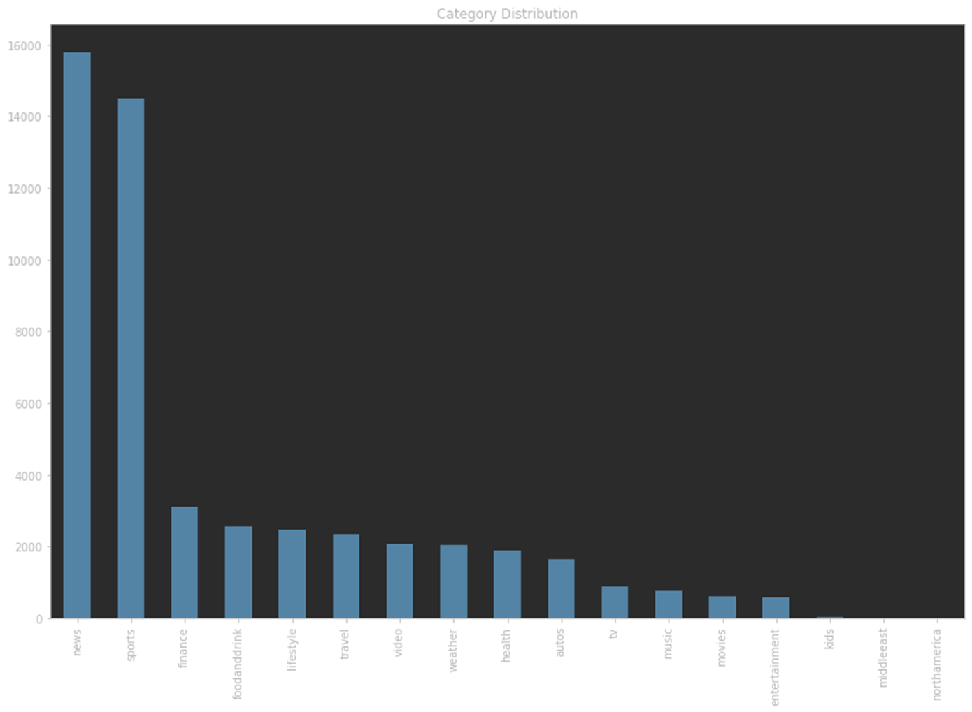
Categories

Slide 8
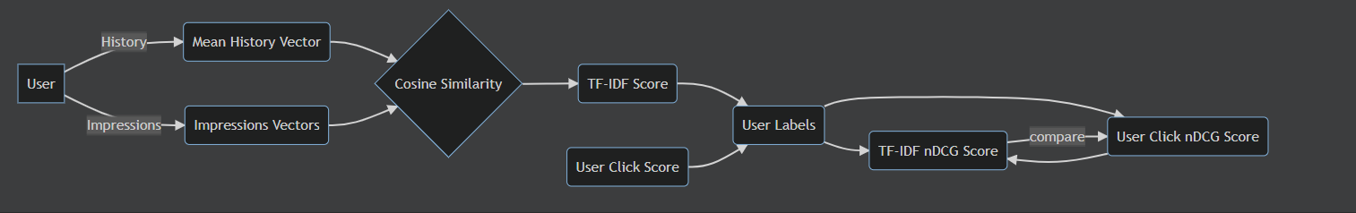
Pure TF-IDF

Slide 9
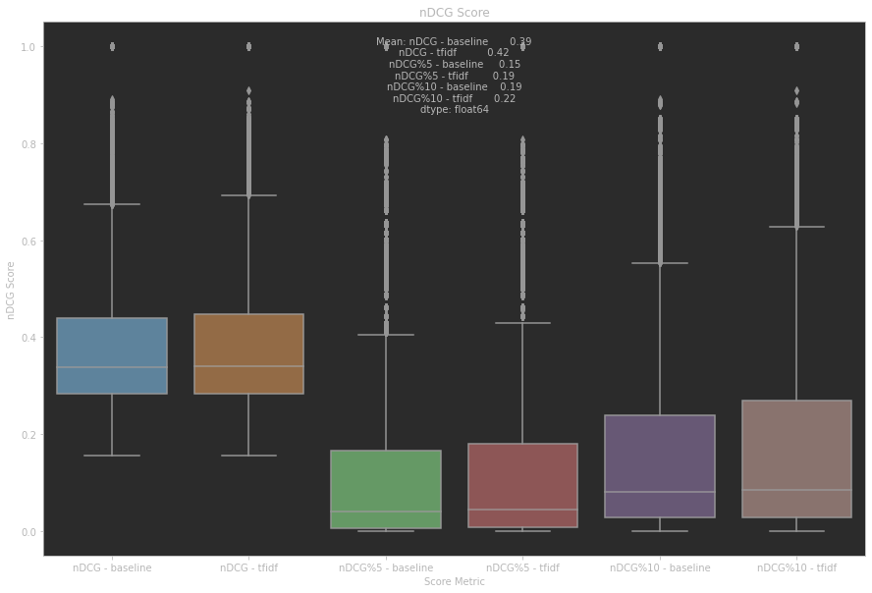
TF-IDF – Results – ‘title’
Better performance overall for recommendations using TF-IDF, using only the title(!)

Slide 10
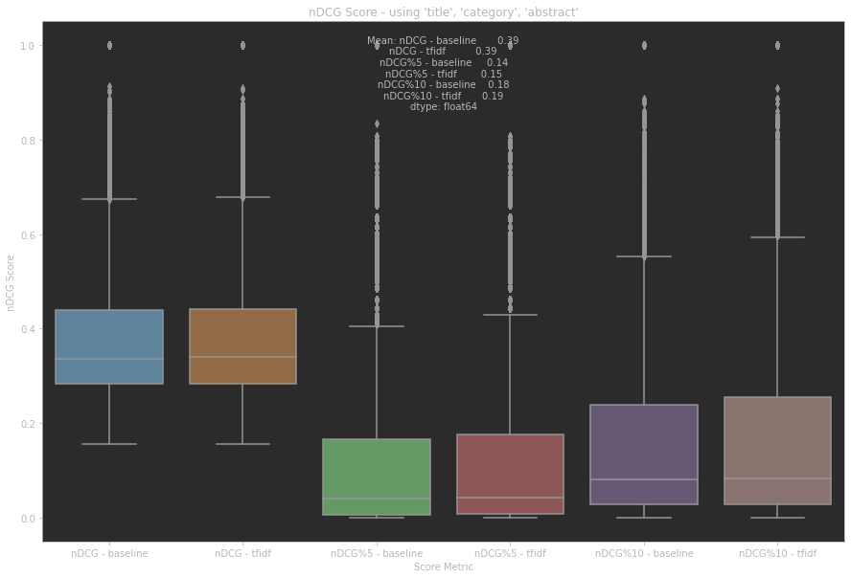
TF-IDF – Results – ‘title’, ‘category’, , ‘abstract’
The performance decreased when introducing the abstract

Slide 11
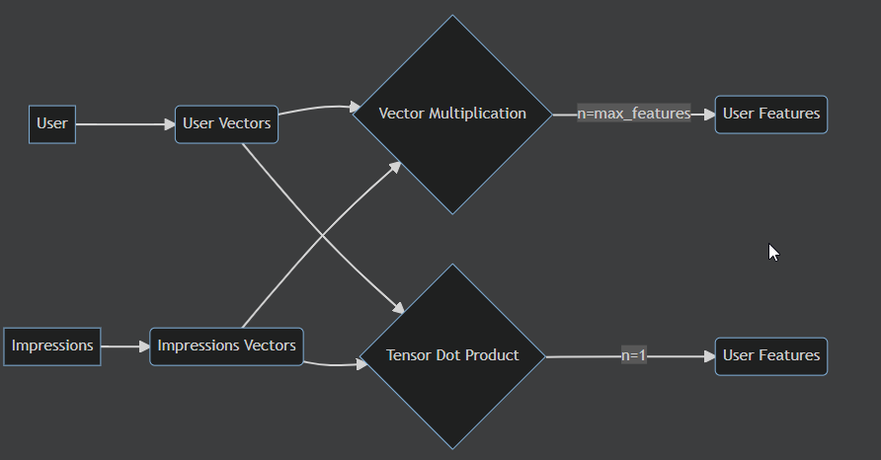
Deep Learning Model
For this approach, we planned 2 strategies:
Vector Multiplication
Tensor Dot
Different representations for the users

Slide 12
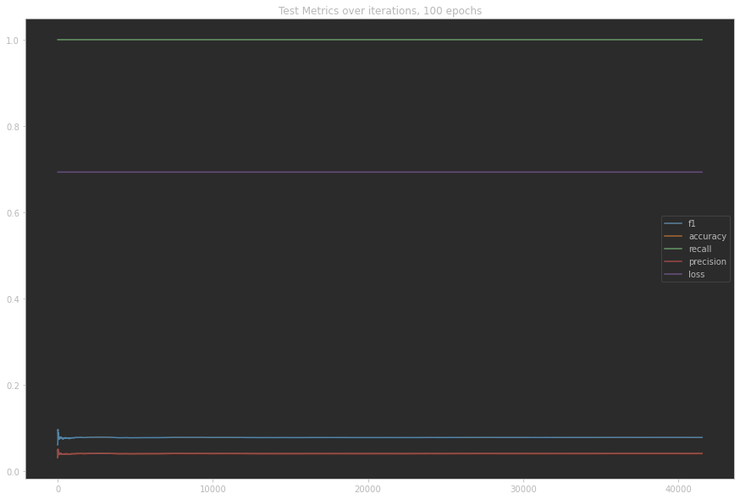
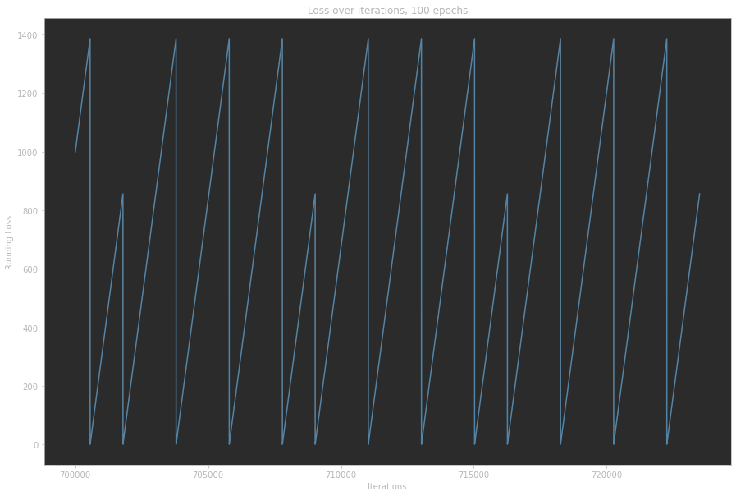
Vector Multiplication

Slide 13
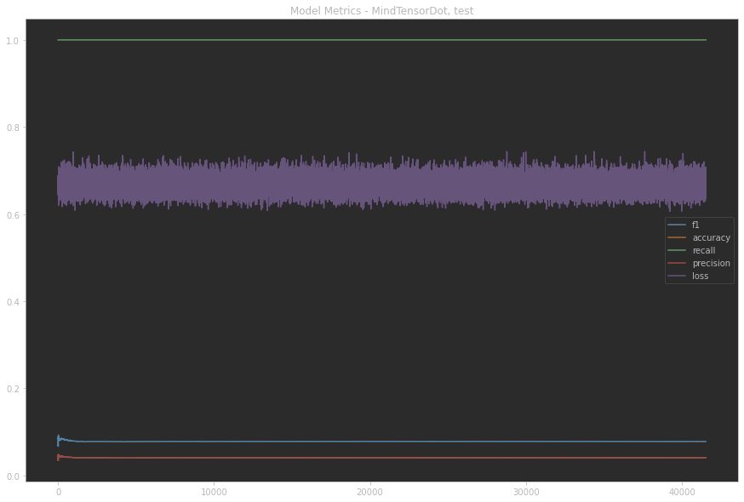
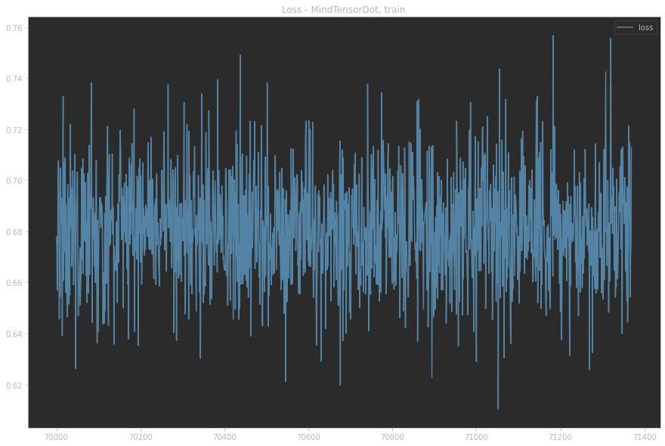
Tensor Dot

Slide 14
Conclusions
Representation of user's history vectors from TF-IDF might not be good for this data
A more advanced user embedding
nDCG metrics to the model

